Slide 1
Partitioning

Slide 2
What is partitioning?
In large systems, we are dealing with tons of data, and as a result tables may become too big/perform too many queries for one single machine.
Partitioning is splitting this table up into many chunks to go on various database nodes.
Partitioning is often used in conjunction with replication.

Slide 3
Objectives of partitioning
On each node we want:
A relatively similar amount of data
A relatively similar amount of reads/and writes to the data
If we are unable to achieve this, certain nodes will be overloaded relative to others, known as hot spots

Slide 4
Methodologies for partitioning
By ranges of keys
By ranges of the hash of keys
Note: do not take a hash of the key and then do a modulo with the number of nodes, as this will cause the location of every key to change if a partition node is added or removed

Slide 5
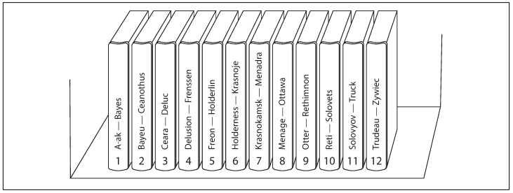
Key Range Partitioning
Not necessarily even ranges, of keys, some ranges may be hotter
Keep keys sorted within a partition to best support range queries
Pros:
Simple and allows for effective range queries
Cons:
Have to actually determine the ranges to make sure they are relatively even in data and load (can be done manually or by database)
Can easily lead to hotspots (if for example partitioning by range of timestamps)

Slide 6

Hash Range Partitioning
Take a hash of the key, and put it into the proper partition
:f22476
f22476:r91mbb
r91mbb:

Slide 7
Hash Range Partitioning
Take a hash of the key, and put it into the proper partition
jordan
:f22476
hash function
f22476:r91mbb
po23av
r91mbb:

Slide 8
Hash Range Partitioning
Take a hash of the key, and put it into the proper partition
jordan
:f22476
hash function
f22476:r91mbb
po23av
r91mbb:

Slide 9
Hash Range Partitioning Tradeoffs
Pros:
Keys are evenly distributed between nodes (assuming good hash function)
Cons:
No more range queries on the partition key, have to check every partition
If a key has a lot of activity will still lead to hot spots

Slide 10
Indexes in a partitioned database configuration
Recall: An index is additional metadata that shows memory addresses of rows corresponding to certain field values in the row
Secondary Index
Position: point guard - [10, 14, 21, 37]
Position: center - [1, 8, 12, 19]
Position: power forward - [5, 11]
Position: small forward - [6, 7, 13, 22]
Position: shooting guard - [3, 15, 16]

Slide 11
Secondary Index Options
Local Indexes
Global Indexes

Slide 12
Local Indexes
Idea: Hold a secondary index that only holds rows from the partition the index is located on
ID | Name | Position
1 | Michael Jordan | Shooting Guard
2 | Lebron James | Small Forward
3 | Kobe Bryant | Shooting Guard
Secondary Index
Position: point guard - []
Position: center - []
Position: power forward - []
Position: small forward - [1, 3]
Position: shooting guard - [2]
ID | Name | Position
65 | Khris Middleton | Small Forward
66 | Chris Paul | Point Guard
67 | Dwight Howard | Center
Secondary Index
Position: point guard - [66]
Position: center - [67]
Position: power forward - []
Position: small forward - [65]
Position: shooting guard - []

Slide 13
Local Index Tradeoffs
Pros:
Fast on write because all data that is being kept track of is being stored locally on the partition
Cons:
Slow on read because if using a secondary index have to query every partition to accumulate the index results

Slide 14
Global Indexes
Idea: Partition the secondary index, the index can contain references to data on any partition
ID | Name | Position
1 | Michael Jordan | Shooting Guard
2 | Lebron James | Small Forward
3 | Kobe Bryant | Shooting Guard
Secondary Index
Position: point guard - [66]
Position: center - [67]
ID | Name | Position
65 | Khris Middleton | Small Forward
66 | Chris Paul | Point Guard
67 | Dwight Howard | Center
Secondary Index
Position: power forward - []
Position: small forward - [2, 65]
Position: shooting guard - [1, 3]

Slide 15
Global Index Tradeoffs
Pros:
Fast on read because all data for that index is being kept on one partition node
Cons:
Slow on write because need to write to multiple partitions to update all of the various secondary indexes
May require a distributed transaction (imagine the case one write succeeds and the other fails)

Slide 16
Rebalancing Partitions
If a node is added or removed, the goal is to keep the majority of the keys in the same place, and only move a few from each node so that we do not use a ton of bandwidth remapping every key (recall to use hash ranges instead of modulo)

Slide 17
Fixed Number of Partitions
In this system, we have 20 partitions no matter how many nodes there are

Slide 18
Fixed Number of Partitions
In this system, we have 20 partitions no matter how many nodes there are
Take all of the white chunks from each server and pass them to the new server!

Slide 19
Fixed Number of Partitions - Considerations
Choose a number of partitions that is reasonable:
If too low, each partition will get too big and we will not be able to scale the application further (additionally transferring the partition to another node will take a super long time)
If too high, there will be a lot of overhead on disk devoted to each partition
If your dataset is going to vary significantly in the future, maybe this isn’t for you

Slide 20
Dynamic Partitioning
Certain databases will adjust partition ranges dynamically so that they can reduce hot spots as the data access patterns change over time:
Once a partition becomes too big, it is split into two pieces and one is assigned to another node
Sometimes dynamic partitioning is not good because if the database incorrectly assumes a node is down, when there is actually just a slow network, it will repartition leading to more strain on the network

Slide 21
Fixed number of partitions per node
Each node has a certain number of partitions on it which grow in size proportionally to the dataset
If a new node joins the cluster it will split some of the partitions on existing nodes into two pieces, and take those for itself
Very similar to consistent hashing algorithm to avoid unfair data splits

Slide 22
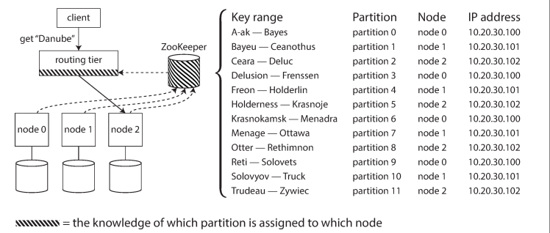
Sharding Summary
Unlike replication, which is always important to have (to increase availability), partitioning adds a lot of complexity to a system and should mainly only be used when the dataset has gotten big enough that putting the whole table on a single node is infeasible.
Generally requires some sort of coordination service or gossip protocol in order to keep track of which range corresponds to which partition

Slide 23
Sharding Summary Continued
Partitioning Methodology:
Key ranges are better when we need to perform range queries
Key hash ranges are better when we want to more evenly distribute data
Index Choices:
Local indexes optimize for write speed
Global indexes optimize for read speed
Rebalancing Choices:
Fixed number of partitions is simpler to reason about, but requires choosing a good number
A changing number of partitions may scale better, but doing so automatically may lead to unnecessarily rebalancing and putting extra stress on our databases

